Slide 1
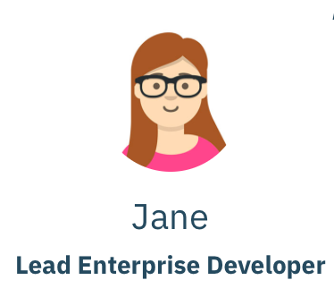







Kabanero Enterprise
Jane works in the Appsody and Codewind Phase
Champ works in the Tekton Phase
Appsody stacks enable development of microservice applications
Appsody CLI implements development and creates applications
Appsody: Development Phase
Push code to Kubernetes Cluster on OpenShift Cloud
++ lorem - - ipsum
→ → → →
Containerize Code
Appsody stacks provides frameworks for Codewind to develop
Codewind: Coding Phase
Install on Local Computer
Begin Code
Debug Code
Test Code
→ → → →
Codewind provides code for Tekton to automate and deploy
Tekton: Deployment Phase

